Slide 1
Annual day of my college

Slide 2
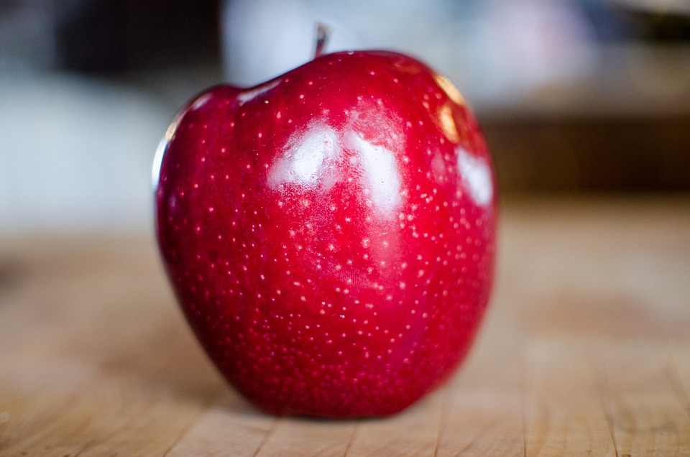
Apple

Slide 3
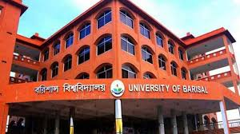
My Campus

Slide 4
Team
Borsha
Ruhi
Elena
Maya
Akhi
Nohore

Slide 5

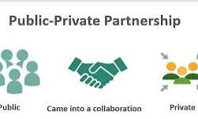
What Are Public-Private Partnerships?

